Slide 1
The battle of neighborhoods
Doha, Qatar

Slide 2
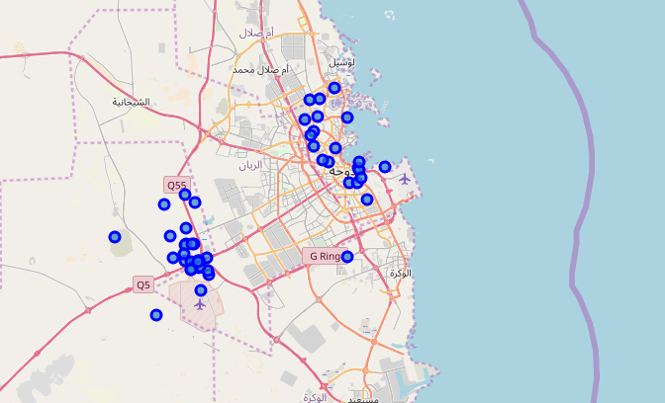
Neighborhoods of doha

Slide 3
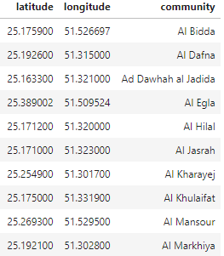
Data about neighborhoods names and location

Slide 5
K means
The method used for clustering in this project and is popular for cluster analysis in data mining. k-means clustering aims to partition n observations into k clusters in which each observation belongs to the cluster with the nearest mean, serving as a prototype of the cluster. This results in a partitioning of the data space into Voronoi cells. k-Means minimizes within-cluster variances

Slide 6
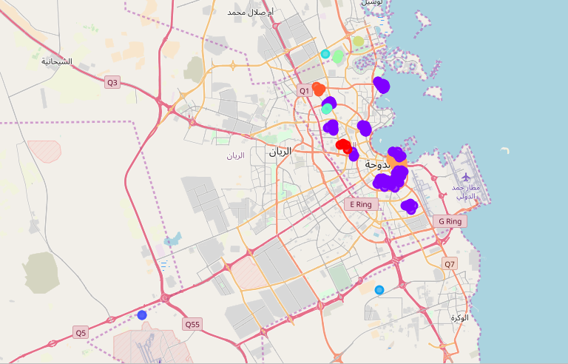
The result
10 clusters of different sizes and characterestics

